Slide 1
Introduction to Feature Extraction

Slide 2
Introduction
Feature extraction describes the relevant shape information contained in a pattern so that the task of classifying the pattern is made easy by a formal procedure.
In pattern recognition and in image processing, feature extraction is a special form of dimensionality reduction.
The main goal of feature extraction is to obtain the most relevant information from the original data and represent that information in a lower dimensionality space.
When the input data to an algorithm is too large to be processed and it is suspected to be redundant (much data, but not much information) then the input data will be transformed into a reduced representation set of features (also named features vector).

Slide 3
Applications of Feature extraction
Feature extraction has been used in many applications such as
character recognition,
document verification,
reading bank deposit slips,
extracting information from cheques,
applications for credit cards,
health insurance, loan, tax forms,
data entry,
postal address reading,
check sorting,
tax reading,
script recognition etc. Character

Slide 4
Feature Extraction
Transforming the input data into the set of features is called feature extraction.
If the features extracted are carefully chosen it is expected that the features set will extract the relevant information from the input data in order to perform the desired task using this reduced representation instead of the full size input.

Slide 5
Feature Extraction
Feature extraction is done after the preprocessing phase
The primary task of pattern recognition is to take an input pattern and correctly assign it as one of the possible output classes.
This process can be divided into two general stages: Feature selection and Classification
Feature selection is critical to the whole process since the classifier will not be able to recognize from poorly selected features

Slide 6
Feature Extraction
Features should contain information required to
distinguish between classes,
be insensitive to irrelevant variability in the input, and
also be limited in number, to permit, efficient computation of discriminant functions and
to limit the amount of training data required

Slide 7
Feature Extraction
Feature extraction is an important step in the construction of any pattern classification and aims at the extraction of the relevant information that characterizes each class.
In this process relevant features are extracted from objects/ alphabets to form feature vectors.
These feature vectors are then used by classifiers to recognize the input unit with target output unit.
It becomes easier for the classifier to classify between different classes by looking at these features as it allows fairly easy to distinguish

Slide 8
Feature Extraction
Feature extraction has been given as “extracting from the raw data information that is most suitable for classification purposes, while minimizing the within class pattern variability and enhancing the between class pattern variability”.
Thus, selection of a suitable feature extraction technique according to the input to be applied needs to be done with utmost care

Slide 9
Feature Extraction and Selection
There are two different approaches to obtain a subset of features: feature extraction and feature selection.
In feature extraction the features that may have discriminating power are extracted, while in feature selection, a subset of the original set of features is selected.
The main idea of features selection is to select a subset of input variables by cutout features with weakly or no predictive information while maintaining or performing classification accuracy.

Slide 10
Relevance of a Feature
Feature relevance can be described as strong and weak relevance.
Strong relevance means that a feature cannot be removed from the feature set without loss of classification accuracy.
Weak relevance means that a feature can sometimes contribute to classification accuracy

Slide 11
Feature Selection Problem
Selecting the most meaningful features is a crucial step in the process of classification problems because:
(1) it is necessary to find all possible feature subsets that can be formed from the initial set which result in time consuming,
(2) every feature is meaningful for at least some of discriminations, and
(3) variations within intraclass and between inter-class is not too much high.
Beyond a certain point, the inclusion of additional features leads to a worse rather than better performance.

Slide 12
Features
A good feature set contains discriminating information, which can distinguish one object from other objects.
It must be as robust as possible in order to prevent generating different feature codes for the objects in the same class.
The selected set of features should be a small set whose values efficiently discriminate among patterns of different classes, but are similar for patterns within the same class.

Slide 13
Features
Features can be classified into two categories:
1. Local features, which are usually geometric (e.g. concave/convex parts, number of endpoints, branches, Joints etc).
2. Global features, which are usually topological (connectivity, projection profiles, number of holes, etc) or statistical (invariant moments etc.)

Slide 14
Classification of Feature Extraction Methods
Feature extraction methods are classified into three major groups as:
Statistical Features
Global Transformation and Series Expansion Features
Geometrical and Topological Features

Slide 15
Statistical Features
These features are derived from the statistical distribution of points.
They provide high speed and low complexity and take care of style variations to some extent.
They may also be used for reducing the dimension of the feature set.

Slide 16
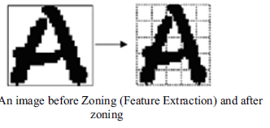
Statistical Features
The followings are the major statistical features:
Zoning
Characteristics Loci
Crossing and Distances

Slide 17
Global Transformation and Series Expansion Features
These features are invariant to global deformations like translation and rotations.
A continuous signal generally contains more information that needs to be represented for the purposes of classification.
One way to represent a signal is by a linear combination of a series of simpler well defined functions.
The coefficients of the linear combination provide a compact encoding known as series expansion.

Slide 18
Global Transformation and Series Expansion Features
Common transform and series expansion features are:
Fourier Transform
Wavelet Transform
Hough Transform
Gabor Transform
Walsh-Hadamard Transform
Karhunen Loeve Expansion

Slide 19
Fourier Transform
The general procedure is to choose magnitude spectrum of the measurement vector as the features in an n dimensional Euclidean space.
One of the most attractive properties of the Fourier Transform is the ability to recognize the position shifted characters when it observes the magnitude spectrum and ignores the phase.

Slide 20
Wavelet Transform
Wavelet transformation is a series expansion technique that allows us to represent the signal at different levels of resolution.

Slide 21
Hough Transform
It is a technique for baseline detection in documents It is also applied to characterize parameter curves of characters

Slide 22
Gabor Transform
The Gabor transform is a variation of the windowed Fourier Transform.
In this case the window used is not a discrete size but is defined by a Gaussian function

Slide 23
Walsh Hadamard Transform
This feature is more suitable in high speed processing since the arithmetic computation involves only addition and subtraction.
The major drawback of Walsh Hadamard transform is that its performance depends heavily upon the position of the characters.

Slide 24
Karhunen Loeve Expansion:
It is an Eigen vector analysis which attempts to reduce the dimension of the feature set by creating new features that are linear combinations of the original features

Slide 25
Geometrical and Topological Features
These features may represent global and local properties of characters and have high tolerances to distortions and style variations.
These topological features may encode some knowledge about the contour of the object or may require some knowledge as to what sort of components make up that object.

Slide 26
Geometrical and Topological Features
Some of the Geometrical and Topological Features are
Strokes
Stroke Directions and Bays
Chain Codes

Slide 27
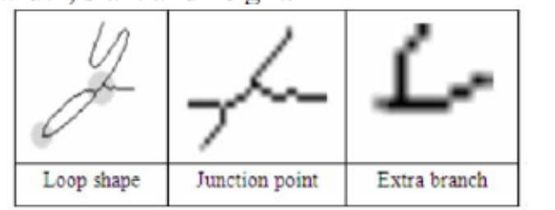
Geometrical and Topological Features
4. End point intersections of line segments and loops
5. Stroke relation and angular properties

Slide 28
Example of GSC features

Slide 29
Example of Feature extraction using Geometric Features

Slide 30
Application: Extracting Features from Characters

Slide 31
Application: Digit Recognition

Slide 32
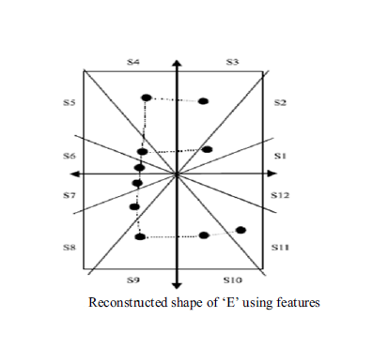
Application: Alphabet Recognition

Slide 33
Application: Alphabet Recognition

Slide 34
Overview of Feature Extraction methods

